Slide 1
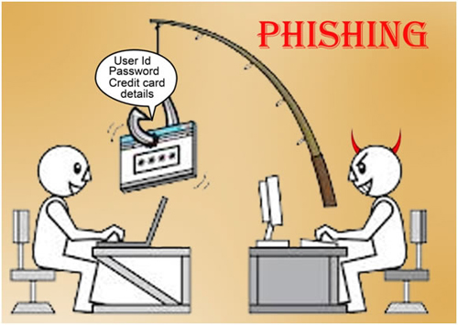
Phishing & Anti-spam classifier
Kenneth Howerton
Yasmeen Cherry
Sarah Gore
CSC 130/01
https://www.youtube.com/embed/yg8NxVcHBlI
https://github.com/howerton3/SpamHamCereal.git

Slide 2
Overview
Define phishing
Define Spam
Define Bayes Theorem
Explanation of SpamHamCereal.py
Summary
References

Slide 3
What is Phishing?
It’s a form of fraud in which the attacker tries to learn information such as login credentials or account information.

Slide 4
Spam Classifying or the Naïve bayes spam
Naïve Bayes Spam filtering is a baseline technique for dealing with spam that can tailor itself to the email needs of individual users.

Slide 5
Bayes Naïve Continue:
Bayes classifiers are a popular statistical technique of email filtering. Classifiers work by correlating the use of tokens with spam and non- spam emails and then using the Bayes theorem to calculate a probability that an email is or is not a spam.

Slide 6
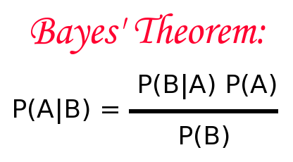
How to calculate the probability

Slide 7
SpamHamcereal
Given a .csv of Cereal names and ingredients, SpamHamCereal will determine whether a given cereal is likely to be Spam or Ham (healthy or unhealthy)

Slide 8
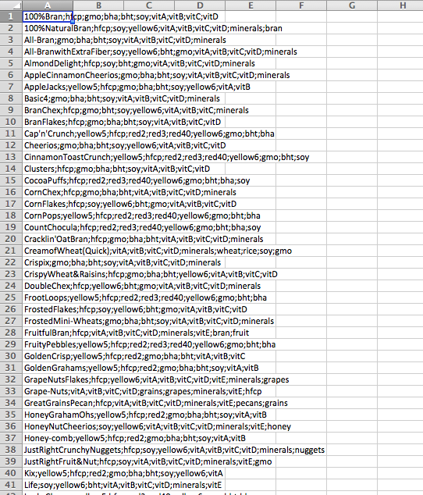
Data type used for “cereal”

Slide 9
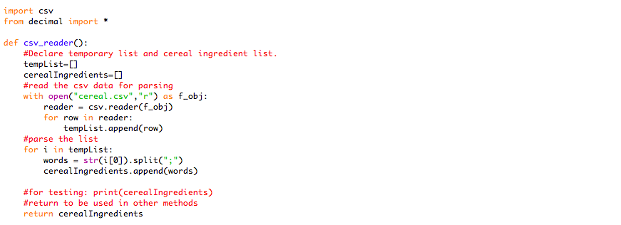
How to calculate the probability

Slide 10
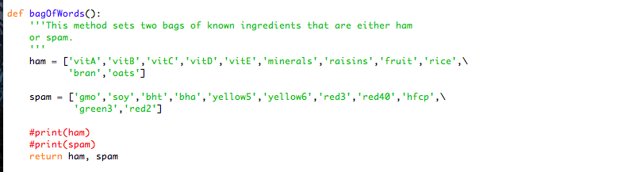
How to calculate the probability

Slide 11
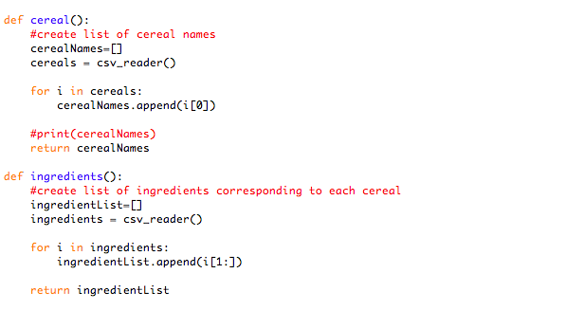
Cereal/ingredients separated

Slide 12
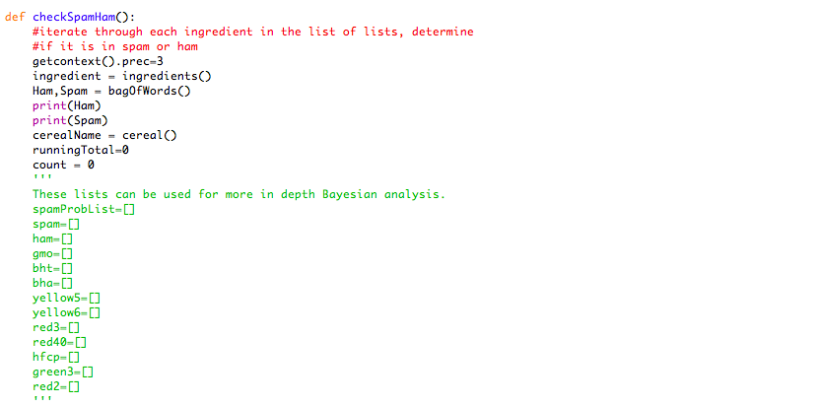
The checker

Slide 13
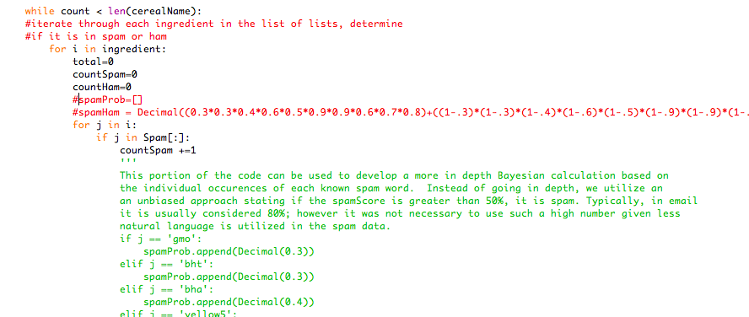
The checker continued

Slide 14
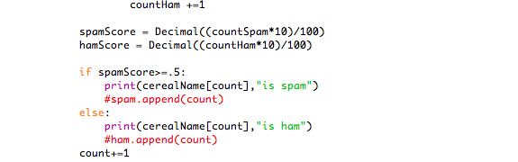
Spam or ham

Slide 15
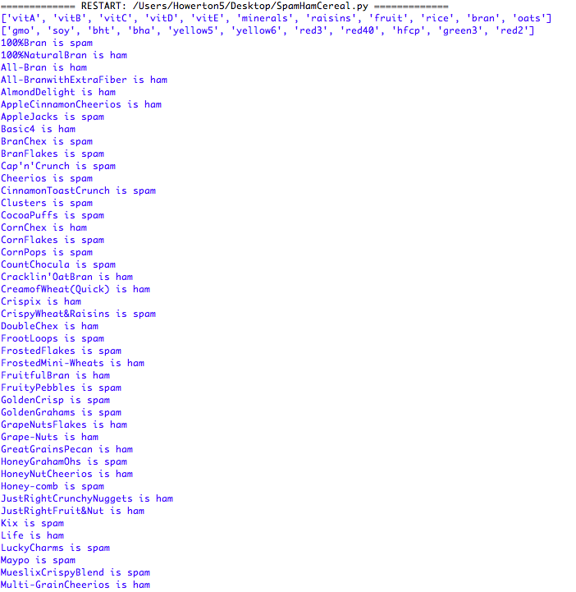
Output

Slide 16
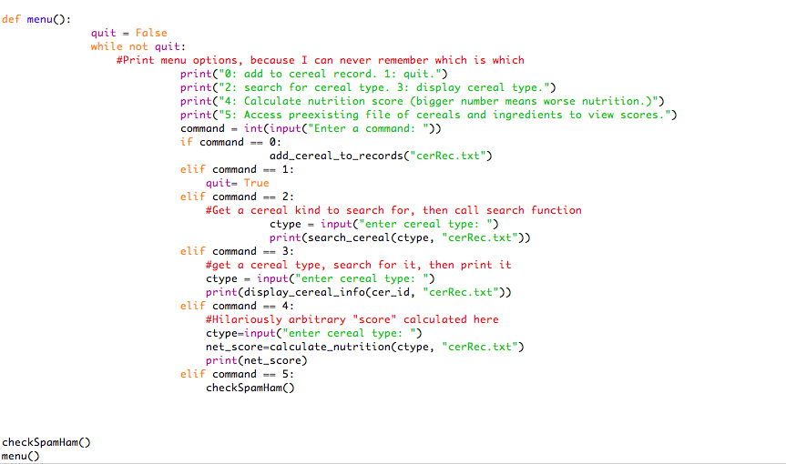
A Menu for customized Entries

Slide 17
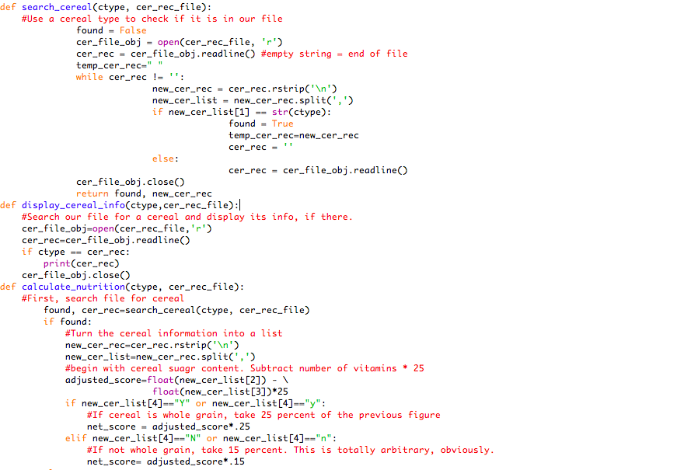
Entering new cereal

Slide 18
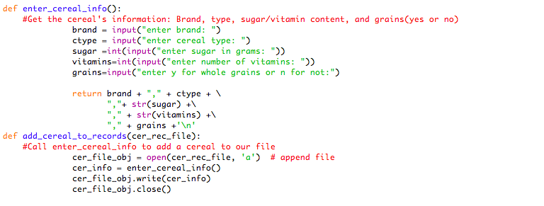
Entering new cereal

Slide 19
summary
Given a “Bag of Words” and data, this model can be easily customized to fit a user’s needs.
Bayes Theorem is not the only method of filtering, but it is a easily customizable method and precision can be increased based on needs of client.

Slide 20
reference
https://github.com/wifiphisher/wifiphisher
https://www.analyticsvidhya.com/blog/2015/09/naive-bayes-explained/
http://searchsecurity.techtarget.com/definition/phishing
Wikipedia contributors. "Naive Bayes spam filtering." Wikipedia, The Free Encyclopedia. Wikipedia, The Free Encyclopedia, 30 Jan. 2017. Web. 26 Apr. 2017.

